Slide 1
RESPONDERS- THE SMART TRAFFIC LIGHT AND STREET LIGHT SYSTEM
TEAM MEMBERS:
MERCY ALBINA.C 211420104158
KOUSHIKA. S.S 211420104138
GUIDE : Dr. KAVITHA SUBRAMANI M.E., P.hD.(PROFESSOR)
Batch no.: A1
SUSTAINABLE DEVELOPMENT GOALS:
SDG 11: Sustainable Cities and Communities
SDG 9: Industry, Innovation, and Infrastructure
SDG 7: Affordable and Clean Energy
SDG 13: Climate Action
SDG 12: Responsible Consumption and Production

Slide 2
ABSTRACT
To improve safety and energy consumption in smart cities, this proposal supports two essential tactics. The first attempt suggests implementing dynamic brightness management for optimal energy efficiency in fog computing-based smart street lamps (SSL). These SSLs can independently report, meaning that individual bulbs can identify and report anomalous conditions, including broken or pilfered lights. According to the study's findings, installing SSLs greatly reduces dangers and improves energy utilization in urban illumination.
By integrating machine learning technologies, the second strategy concentrates on intelligent traffic management. To improve traffic control, a system that uses automation and the Internet of Things to operate barricades on roads is being introduced. You only look once algorithms for object identification distinguish between free and crowded highways, recommending alternate routes to ease traffic congestion. These actions address careless driving, improve traffic flow, and increase road safety.
In summary, the combination of Smart Street Lamps (SSLs) and intelligent traffic management systems hold the promise of ushering in smarter, safer, and more energy-efficient cities by effectively tackling issues associated with street lights, traffic congestion, and speeding vehicles. All things considered, this integrated strategy is a positive step toward developing technologically sophisticated and sustainable cities.

Slide 3
INTRODUCTION
The Internet of Things (IoT) represents a groundbreaking technology capable of seamlessly integrating diverse and heterogeneous end systems to enable a broad array of digital services. This transformative innovation is propelling the world toward intelligent and automated management of systems.
The increase in the number of vehicles has led to traffic congestion, pollution, and disruptions in transit operations. Utilizing IoT for traffic regulation and effective congestion management becomes a crucial game-changer. The proposed concept aims to develop an IoT system for autonomous traffic management. This system, inspired by railway practices, summons a barricade when the traffic light is red and releases it when the light turns green, ensuring a safe passage for pedestrians.
This approach aims to raise awareness among drivers about their actions, promoting a safer road environment.
To enhance traffic flow, object detection is employed. In the ever-evolving landscape of urban development, the principles of safety and energy efficiency stand out as fundamental pillars in shaping smart cities.

Slide 4
INTRODUCTION
In the ever-evolving landscape of urban development, the principles of safety and energy efficiency stand out as fundamental pillars in shaping smart cities. Within the intricate fabric of a metropolis, the synergy between safety and energy conservation converges uniquely in street lamps, making them indispensable components of the smart city paradigm.
However, the current absence of intelligent elements in conventional street lighting poses challenges related to both risk and energy usage.
To navigate this terrain, a forward-thinking strategy introduces the concept of fog computing-based smart street lamps (SSL) as a transformative solution for smarter cities. This innovative approach not only empowers dynamic brightness control but also instills a heightened level of autonomy in each street lamp, enabling it to report and address unusual circumstances independently.
As we delve into the advantages and findings of this proposed SSL system, it becomes evident that the fusion of technology and urban infrastructure holds the promise of lowering risk and elevating energy efficiency in our urban spaces.

Slide 5
LITERATURE REVIEW
TITLE | AUTHOR | FINDINGS | LIMITATION
Design and Development of IOT Based Automated Railway Level Crossing(IEEE) | Puja Bhowmik, Shoriful Islam, Jariatullah Khanam Sifat, Md. Shihab Mahmud, Fahad Faisal | IOT Based automated level crossing for railways, sensor-based system in which two sensors are used to detect the arrival and departure of the train. | Usage of sensors on the road will prove to be harmful
Advance study of skin diseases detection using image processing methods NVEO(2022)(IEEE) | Jagdis etal., Cruz-Vargas J.A.D.L., Camacho M.E.R. | Using wavelet analysis and KNN and SVM classification algorithms, authors applied fuzzy clustering to fifty example photos. | With an accuracy of 81.2%, the K-Nearest Neighbor classification algorithm outperforms the Support Vector Machine (SVM) classification method.
IOT BASED HEALTH MONITORINGSYSTEM, Research Gate 2020(IEEE) | Prajoona Valsalan, Tariq Ahmed Barham Baomar, Ali Hussain Omar Baabood | smart patient health tracking system utilizing sensors embedded. The collected temperature, heartbeat, humidity, and room temperature data are transmitted to a base station via IoT cloud | Sensors used by the system to track temperature, heart rate, body temperature, and ambient humidity were also shown on an LCD which acquired the efficiency of 67%

Slide 6
JOURNAL NAME | AUTHORS | TITLE | FINDINGS | LIMITATIONS
IEEE, 2021 2nd SEA-STEM International Conference (SEA-STEM) | Basla Siripatana; Kittipong Nopchanasuphap; Somporn Chuai-Aree | Intelligent Traffic Light System Using Image Processing | The paper was designed and developed by using image processing technology to process the appropriate waiting time from each image frame. | They have only stimulated an have not implemented in any place.
IEEE,2021 8th International Conference on Computer and Communication Engineering (ICCCE) | Heru Nurwarsito; Hendi Nugroho | Implementation of Smart Traffic Light Prototype Using MQTT Protocol For Emergency Vehicles | the GPS device will send location data to the cloud using MQTT protocol and then the data will be processed and forwarded by the cloud to the traffic light device also using MQTT protocol. | vehicle embedded sensors mentioned here cannot be fixed in all vehicles therefore creating a confusion among sensor fixed and not fixed vehicles.
IEEE, 2022 11th International Conference on System Modeling & Advancement in Research Trends (SMART) | Dilip Kumar Sharma; Rahul Pradhan; Ruchi Agrawal | Comparative Study on Real-Time Vehicle Classification | Comparison of the two most popular machine learning models, SVM, and YOLO for the detection of vehicles on the same dataset | This is just an comparative study proving that YOLO is the best algorithm to identify overspeeding vehicles.
IEEE, 2021 International Conference on Disruptive Technologies for Multi-Disciplinary Research and Applications (CENTCON) | Hari Chandan T.; Shamanth Nagaraju; Bharath Nandan Varma; Kiran Kumar M.; Manasa S.; Mukund K. V. | IoT based Vehicle Over-Speed Detection and Accident Avoidance System Publisher: IEEE Cite This PDF | The ultrasonic sensor detects the object/vehicle ahead of the vehicle and sends the data to Arduino UNO, if a particular vehicle is in close proximity to the front vehicle, the proposed system automatically controls and detects the vehicle speed. | As already mentioned implementation of sensors or iot kits in private vehicles is hard to achieve.
IEEE,2016 2nd International Conference on Contemporary Computing and Informatics (IC3I) | Ravi Kishore Kodali; M. Sairam | Over speed monitoring system | This system calculates the speed and GPS coordinates continuously and these GPS coordinates help to find out the area in which the vehicle has been present and the maximum speed allowed in the respective area. | Again usage of GPS is actually very risky as if the GPS fails the whole system would prove to be an failure .

Slide 7
EXISTING SYSTEM
The barricade system has already been implemented in various places.
A few of them include, the barricades used to prevent pedestrians and vehicles to pass the railway tracks by closing the path to cross the track when a train passes by. The railway barricades are manually operated in some places whereas most foreign countries use sensors to lift them automatically. The usage of barricade can also be witnessed in tollgates to stop the vehicle until the pass is given. But the tollgate system involves manual movement of the barrier .
Automate Systems Ltd provides a range of automatic traffic barriers for vehicles. The most popular being a RIB barrier. These barriers are highly effective and can be easily seen and as well as are easy to use.
The barriers can be based on multiple factors- the type of vehicles, the type of environment etc.
Philips CityTouch is the example model taken for this project, it has a remote monitoring and control and a dynamic brightness control for energy efficiency.

Slide 8
PROPOSED SYSTEM
It is evident from the problem definition that the technology currently in use cannot manage issues like traffic control, emergency vehicle clearance, protection of pedestrians from vehicles that violate traffic signals, etc.
. The lighting system communicates information about street lamp problems to the control center, with an emphasis on energy saving and autonomous operation at low, affordable prices for the streets. Furthermore, errors done by hand can be reduced to a minimum or perhaps completely avoided
We suggest using our Intelligent Traffic Control System to address these issues.
The basic working of the system is as follows:
The automated barricade summons the barrier when the traffic signal is red and expels it when it is green which allows a safe environment for the pedestrians to pass through and also helps us to control vehicles from jamming the roads without following the traffic light rules.
The sensor identifies any ambulance that is within 100 meters from the traffic signal and if any exists, the sensor does not summon the barrier until the ambulance crosses the traffic signal.

Slide 9
PROPOSED SYSTEM
The proposed system also consists of the traffic density detection function which helps in identifying the lanes with heavy traffic and helps alternate the traffic signal thus regulating traffic flow.
The street lighting system determines whether or not it should switch on or off the lights based on the weather
An LDR sensor determines how bright or dark the sky is. In bright weather, the electrical system will be off, and in dark weather, it will be on.
The lamp's illumination is also checked using the light level and an LDR sensor.

Slide 10
PROPOSED SYSTEM
The main components of the suggested system are as follows:
1) An intelligent, light-adjusting street lamp that detects inappropriate behavior and sounds an alarm.
2) A dependable network that allows for real-time communication. While many street lights are linked to servers using NB-IoT, managers are attached to servers via Wi-Fi as well as 5G internet technologies.
3) An adaptable management framework that can improve the distribution of resources for a straightforward, highly automated administration system.
4) An automated traffic barrier that drops when the traffic signal is red and rises when the signal is green.
5) The sound sensor that picks up the sound of emergency vehicles and creates a green lane using traffic signals for their passage.
6) And also identify the lane that has the heaviest traffic and alternate traffic signals accordingly to promote the flow of the traffic.

Slide 11
TECHNOLOGY STACK
Hardware Setup:
Raspberry Pi
Sound Sensor
Traffic Lights, LEDs, and Barriers
IR sensor
Voltage Sensor
LDR Sensor
MQ-2 Gas Sensor
DHT11 Temperature and Humidity Sensor
Relays
Software Setup:
PYTHON
FTT
YOLO

Slide 12
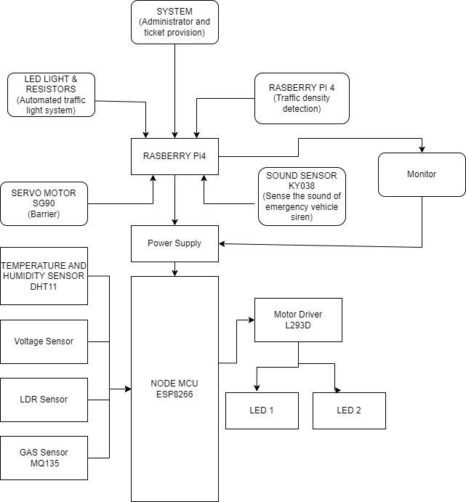
SYSTEM ARCHITECTURE

Slide 13
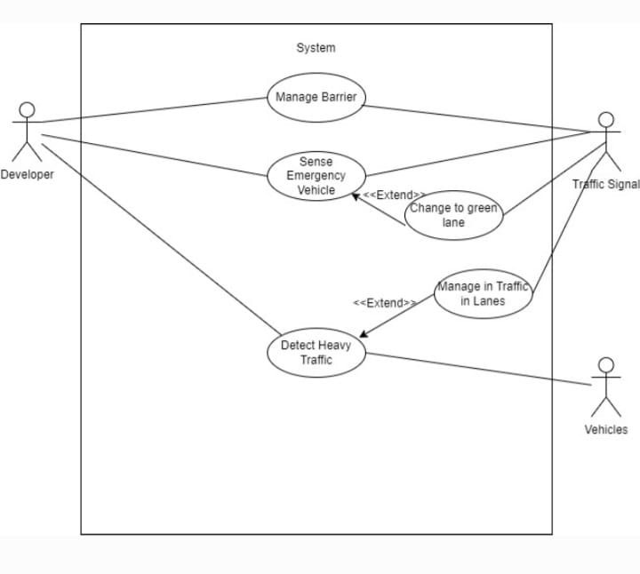
MODULE DESIGN
USECASE DIAGRAM

Slide 14
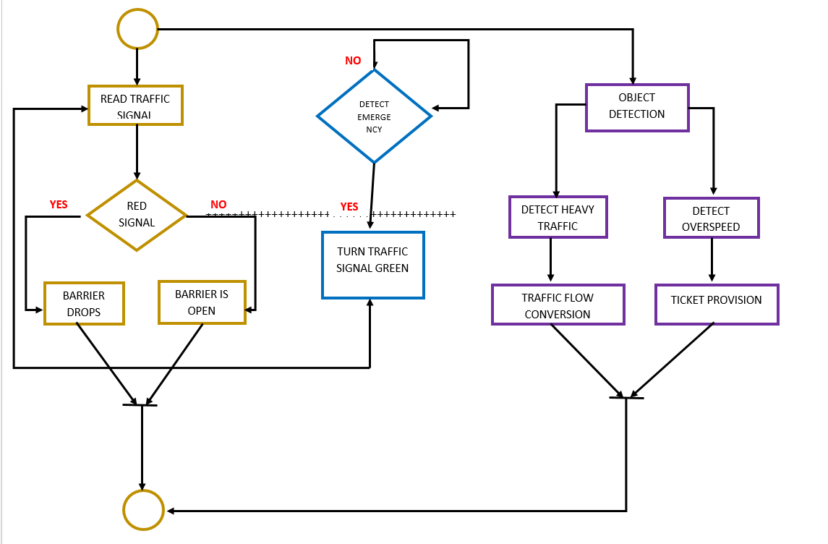
MODULE DESIGN
ACTIVITY DIAGRAM

Slide 15
SYSTEM IMPLEMENTATION
A. WEBSTER'S METHOD FOR TRAFFIC SIGNAL TIMING:
• The Webster method class implements a traffic signal timing methodology inspired by Webster's method. It adjusts green and red signal durations based on traffic density.
• The cycle length is initially set to 30 seconds, and adjustments are made depending on the traffic density.
B. TRAFFIC SIGNAL CONTROL:
• The Traffic Signal Control class manages the traffic lights at different directions (north, south, east, west).
• It uses the YOLO (You Only Look Once) object detection model to measure traffic density by detecting vehicles in a video frame.
• The update traffic signal method updates traffic light durations based on traffic density using Webster's method.
• Traffic lights are then controlled to signal green and red durations accordingly.

Slide 16
SYSTEM IMPLEMENTATION
C. TRAFFIC SIGNAL AND BARRIER SYSTEM:
• The Traffic Signal and Barrier System class integrates traffic signal control, barrier control, overspeed detection, and ambulance detection.
• It initializes traffic lights, barriers, overspeed detection components, and an ambulance detection system.
• The calculate green duration method calculates the green time based on traffic density using a specified formula.
• The update traffic signal method controls traffic lights and barriers based on the calculated green time and predefined red time.
• Over speed detection involves capturing video frames, detecting moving objects, and checking if the detected speed exceeds a predefined threshold.
• Ambulance detection monitors sound sensor input and responds by turning traffic lights green.
D. AUDIO PROCESSING AND EMERGENCY SOUND DETECTION
• The sound sensor processing method collects audio samples, applies windowing, and performs FFT (Fast Fourier Transform) to detect peak frequencies. An emergency sound is detected if the peak frequency corresponds to predefined criteria.
E. DYNAMIC LIGHT ADJUSTMENT
• Based on the readings from the LDR sensor, dynamically adjust the brightness of the street lights. Save energy by dimming lights when sufficient natural light is available. Monitors the voltage levels in the street lighting system.

Slide 17
SYSTEM IMPLEMENTATION
F. GAS MONITORING:
• Use data from the MQ-2 Gas Sensor to detect the presence of harmful gases and take appropriate actions (e.g., alerting authorities).
G. TEMPERATURE AND HUMIDITY MONITORING
• Monitor temperature and humidity levels for environmental awareness. Serially transmits temperature and humidity measurements. Measures temperature in the range of 0 to 50°C and relative humidity from 20% to 90% RH
H. RELAY CONTROL
• Utilize relays to control the ON/OFF status of the street lights.
• Programmatically adjust lighting based on external factors.
I. ENERGY EFFICIENCY
• Optimize street lighting based on surroundings and time of day to save energy.
• Lower light pollution by adjusting brightness levels

Slide 18
YOLO (YOU ONLY LOOK ONCE) ALGORITHM
YOLO is an object detection algorithm that is designed to detect and classify objects in images or video frames. It divides the input image into a grid and predicts bounding boxes and class probabilities for each grid cell in a single forward pass.
Input Processing
Before feeding the image to YOLO, it is preprocessed into a format suitable for the model. This involves converting the image to a blob, a structured format that can be used as input to the neural network.
Integration into the Traffic System
The YOLO-based traffic density estimation is a crucial component of the larger traffic signal and barrier system. It provides real-time information about traffic conditions, allowing the system to adapt and optimize traffic signal timings for efficient traffic management.

Slide 19
FTT(Fast Fourier Transform)ALGORITHM
The Fast Fourier Transform (FFT) algorithm is utilized for processing audio data from a sound sensor. The primary goal is to analyze the frequency content of the collected audio samples to identify specific patterns, particularly an emergency sound indicative of an ambulance.
FFT Processing
The Fast Fourier Transform (FFT) is applied to the windowed audio data. FFT is an algorithm that efficiently computes the Discrete Fourier Transform (DFT), revealing the frequency components present in the signal.
Emergency Sound Detection
The code checks whether the identified peak frequency corresponds to an emergency sound indicative of an ambulance.
Peak Frequency Detection
The frequency with the highest magnitude in the spectrum is identified. This is determined by finding the index of the maximum magnitude in the FFT result and converting it to a frequency value.

Slide 20
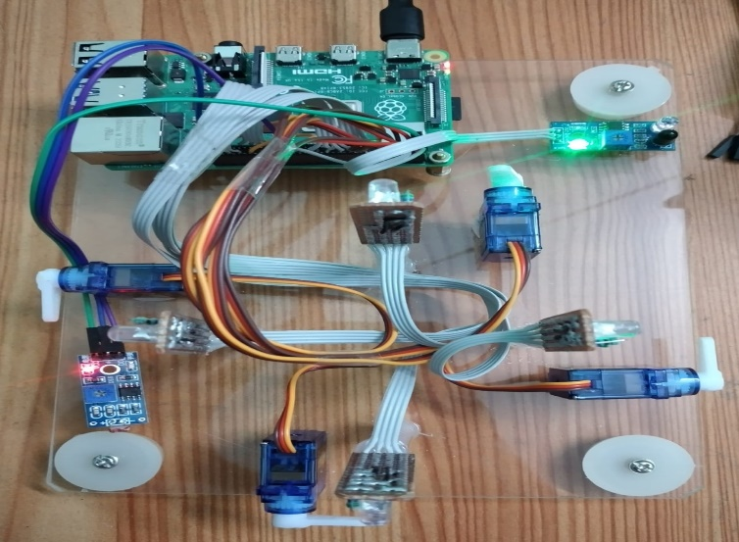
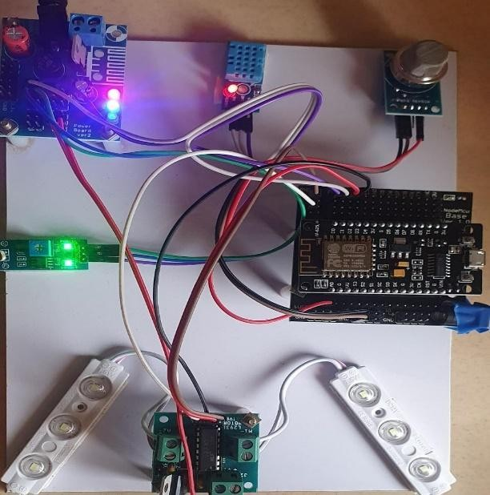
OUTPUT
SYSTEM WORKING
SYSTEM WORKING

Slide 21
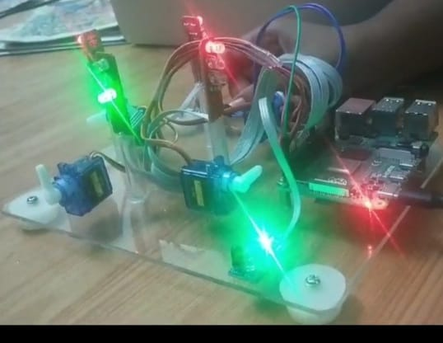
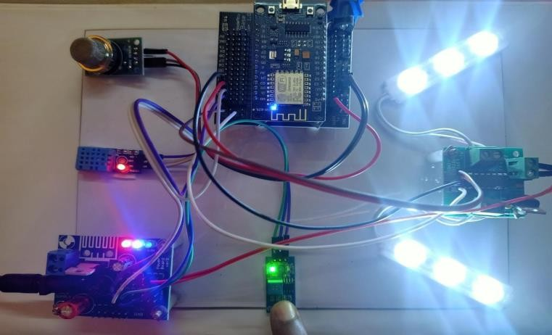
OUTPUT
RED LIGHT
LED WORKING UNDER CONDITION GIVEN

Slide 22
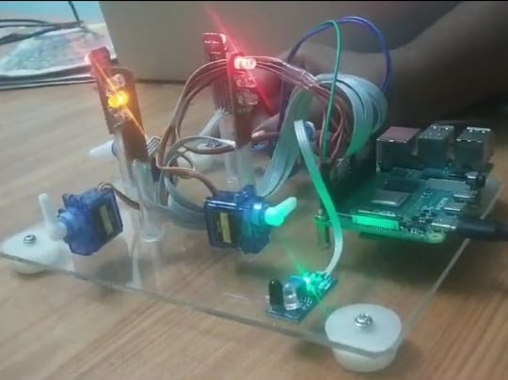
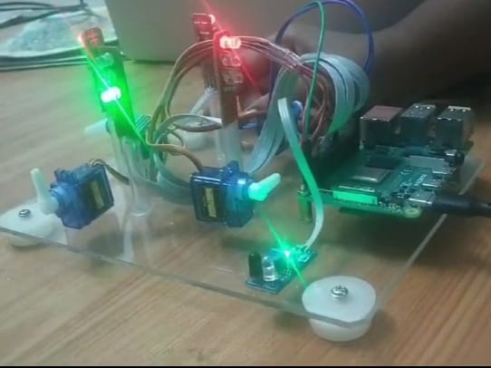
OUTPUT
GREEN LIGHT
YELOW LIGHT

Slide 23
TESTING
TEST CASE ID | TESTCASE/ ACTION TO BE PERFORMED | EXPECTED RESULT | ACTUAL RESULT | PASS/ FAIL
TC001 | Red light displayed in traffic light | Barrier drops | Barrier drops as given in Figure A3.6 | Pass
TC002 | Yellow light displayed in traffic light | Barrier remains dropped. | Barrier remains dropped as given in Figure A3.8 | Pass
TC003 | Green light displayed in traffic light | Barrier is lifted | Barrier is lifted as given in Figure A3.7 | Pass
TC004 | Detects emergency vehicle. | The red signal is converted to green and the Barrier is lifted | The red signal is converted to green and Barrier is lifted | Pass
TC005 | DTH 11 sensor senses humid or lowered temperature | The streetlight shines brighter | The street light shines brighter as given in Figure A3.2 | Pass
TC006 | LDR sensor senses bright lights | The streetlight shines less | The street light shines less as given in Figure A3.2 | Pass
TC007 | MQ-2 sensor senses smoke, CO, and LPG | Reports activity | Reports activity as given in Figure A3.1 | Pass
TC008 | YOLO algorithm detects objects (vehicles) | Detects vehicle and performs traffic flow conversion. | Detects vehicle and performs traffic flow conversion. as given in Figure A3.5 | Pass

Slide 24
CONCLUSION
The methodology proposed in this paper tackles challenges related to green edge computing in smart cities. Introducing the concept of trust, this approach empowers agents to learn from each other's behavior, optimizing decisions for reliable and energy-efficient compute offloading.
Thoroughly examined in a simulation environment, the Trust-based Multi-agent strategy exhibits superior performance compared to conventional methods in terms of energy consumption, work completion time, and resource utilization. In summary, this method stands as a viable solution for dependable and energy-efficient compute offloading in smart cities, with the potential to enhance the functionality of various smart city applications.
Further research is warranted to delve deeper into these possibilities. As technology continues to advance, an increasing number of devices, products, and everyday items are incorporating wireless chips and sensors for seamless communication.
The global economy appears poised to reap substantial benefits from the Internet of Things (IoT). The evolution of IoT into the broader concept of the Internet of Everything (IoE) encompasses the integration of people, data, and applications across all devices.
Technologies once considered science fiction, such as driverless cars, wearable computers, and personalized advertisements, have transitioned into reality, marking a transformative era in technology. This ongoing technological revolution aims to continually enhance output and performance to meet evolving demands.

Slide 25
REFERENCE
[1] L. Atzori, A. Iera, and G. Morabito, “The internet of things: A survey,”Comput. Netw., vol. 54, no. 15, pp. 2787–2805, 2010.
[2] Andrea Zanella, Nicola Bui, Angelo Castellani,Lorenzo Vangelista,and Michele Zorzi,"Internet of Things," IEEE INTERNET OF THINGS JOURNAL, VOL. 1, NO. 1, FEBRUARY 2014"
[3] PaThis Projectl Nowodzinski, Katarzyna Łukasik, and Agnieszka Puto,"Internet Of Things (Iot) In A Retail Environment.",European Scientific Journal
[4] Vanessa Viegas -Why is India's traffic still among the worst in the world? Travel, Hindustan Times,
[5] Dipak K Dash -Mumbai & Bengaluru among top 10 most congested cities in world
[6] Megha Sood-Traffic violations in city rose by 25% last year .Hindustan Times-Mumbai, India
[7] India experiences 79 per cent rise in road accident deaths due to red-light
[8] Ram Sundaram and Sindhu Kannan-Chennai has no room for its pedestrian. The Times Of India - Chennai,lndia
[9] A) Y Maheswara Reddy-CROSS THE LINE TO PAY FINE,Bangalore Mirror Bureau ,The Times of India - Bangalore,lndia B) Jagadish Angadi-Cameras in city to check signal jump Deccan Herald- Bengaluru, India
[10] Mannering, F. L., and Washburn, S. S.(2012). "Principles of Highway Engineering and Traffic “ 5th edition. New York, NY, USA: Wiley, pp. 135-151.
[11] Gerlough, D. L. and Schuhl, A. (1955)"Use of Poisson Distribution in Highway Traffic". Saugatuck, CT, USA: Eno Foundation for Highway Traffic Control, 1955, pp. 3-35.

Slide 26
REFERENCE
[12] Sharma, N., Arkatkar, S. S., and Sarkar A. K. (201 1) "Study on heterogeneous traffic flow characteristics of a twolane road," Transport,26(2)pp.185-196.
[13] Xion, L., & Wang, Z. (2011). "Internet of Things: A New Application for Intelligent Traffic Monitoring System", Journal of Networks6(6),887-894.
[14] Kang, B., Park, S., Lee, T. & Park, S. (2015). "IoTbased monitoring system using tri-level context making model for smart home services", Consumer Electronics (ICCE), IEEE International Conference on.
[15] Jin, J., Gubbi, J., Marusic, S. &Palaniswami, M. (2014). "An Information Framework for Creating Smart City through Internet of Things", IEEE Internet of Things Journal, IQ), 112 - 121.
[16] Shobana S; Shakunthala M ;C. Vimala Josphine; M. Theodore Kingslin; S. Sivarajan; Chairma Lakshmi K R (2023)” IoT based on Smart Traffic Lights and Streetlight System” IEEE, 2023 2nd International Conference on Edge Computing and Applications (ICECAA)
[17] Mohd. Saifuzzaman ,Nazmun Nessa Moon ,Fernaz Narin Nur -IOT Based Street Lighting And Traffic Management System -2017 IEEE Region 10 Humanitarian Technology Conference (RI 0-HTC)21 - 23 Dec 2017, Dhaka, Bangladesh
[18] Puja Bhowmik,Shoriful Islam, Jariatullah Khanam Sifat,Md. Shihab Mahmud,Fahad Faisal-Design and Development of IOT Based Automated Railway Level Crossing2022 IEEE - Dhaka, Bangladesh

Slide 27
REFERENCE
[19] Naoki Kodama, Taku Harada and Kazuteru Miyazaki(2021)“Traffic Signal Control System Using Deep Reinforcement Learning With Emphasis on Reinforcing Successful Experience” IEEE, OPEN ACCESS JOURNEL, Digital Object Identifier.
[20] Hanaa Abohashima; Mohamed Gheith; Amr Eltawil” A proposed IoT based Smart traffic lights control system within a V2X framework” IEEE, 2020 2nd Novel Intelligent and Leading Emerging Sciences Conference (NILES)
[21] Heru Nurwarsito; Hendi Nugroho” Implementation of Smart Traffic Light Prototype Using MQTT Protocol For Emergency Vehicles” IEEE,2021 8th International Conference on Computer and Communication Engineering (ICCCE)
[22] Hari Chandan T.; Shamanth Nagaraju; Bharath Nandan Varma; Kiran Kumar M.; Manasa S.; Mukund K. V.” IoT based Vehicle Over-Speed Detection and Accident Avoidance System” IEEE, 2021 International Conference on Disruptive Technologies for Multi-Disciplinary Research and Applications (CENTCON)
[23] Ravi Kishore Kodali;M. Sairam” Over speed monitoring system” IEEE,2016 2nd International Conference on Contemporary Computing and Informatics (IC3I)
[24] Dilip Kumar Sharma;Rahul Pradhan; Ruchi Agrawal” Comparative Study on Real-Time Vehicle Classification” IEEE, 2022 11th International Conference on System Modeling & Advancement in Research Trends (SMART)
[25] A. Al-khaykan, A. J. Alrubaie, K. A. Mohammed, A. M. Abed and Y. I. Alyasiri, "Comparison Between the Traditional and Solar System Street Lighting System," 2022 Muthanna International Conference on Engineering Science and Technology (MICEST), Samawah, Iraq, 2022, pp. 147-151.
[26] H. Sun, Y. Chen, L. Wang, J. Song, J. Sun and X. Liu, "Design of smart street light management system based on Internet of Things," 2022 IEEE 6th Advanced Information Technology, Electronic and Automation Control Conference (IAEAC), Beijing, China, 2022, pp. 998-1003.
[27] Y. Wang, Z. Deng, K. Tao, T. Liu, X. Bao and B. Cheng, "Intelligent Urban Street Lighting System based on IoT Cloud Platform," 2022 9th International Conference on Dependable Systems and Their Applications (DSA), Wulumuqi, China, 2022, pp. 192-197.

Slide 28
REFERENCE
[28] J. Wang, Z. Jiao, Q. Wang, Y. Zhu and K. Li, "Analysis of Novel 5G Wireless Communication Coverage Enhancing Service Mode with Power Towers and Street Lamp Poles Integrated," 2022 IEEE 6th Information Technology and Mechatronics Engineering Conference (ITOEC), Chongqing, China, 2022, pp. 1215-1220
[29] X. Zeng and J. Zhang, "Design of intelligent light control system based on NB-IoT," 2022 International Conference on Wearables, Sports and Lifestyle Management (WSLM), Kunming, China, 2022, pp. 84-87.
[30] K. -K. Lai, A. K. -W. Weng and H. -Y. Chang, "Literature Development Trajectory of LED Smart Street Lighting by Main Path Analysis," 2022 IEEE 28th International Conference on Engineering, Technology and Innovation (ICE/ITMC) & 31st International Association For Management of Technology (IAMOT) Joint Conference, Nancy, France, 2022, pp. 1-5.
[31] S. Kanase, V. B. Mane, M. A. Suryawanshi, G. Kumbhar, V. Jamadar and P.P. Patil, "The Significant Effect of Saving One Unit of Electricity and the Role of Non-Renewable Energy Based Street Light in Saving the Energy," 2022 International Interdisciplinary Humanitarian Conference for Sustainability (IIHC), Bengaluru, India, 2022, pp. 807-810.
[32] Y. Tan, C. Wooi, H. N. Afrouzi, S. N. b. Md, O. b. Abu Bakar and W. Tan, "Simulations of Street Lighting System Using DIALux for Better Energy-Saving Application," 2022 IEEE International Conference on Power and Energy (PECon), Langkawi, Kedah, Malaysia, 2022, pp. 374-378.
[33] U. Khayam and A. Zaeni, "Review of Smart Street Lighting Research in Indonesia," 2022 5th International Conference on Power Engineering and Renewable Energy (ICPERE), Bandung, Indonesia, 2022, pp. 1-4.
[34] B. M. Mrabet, A. Chammam, L. Canale and G. Zissis, "Design and Implementation of LEDs Boost Driver for street lighting system," 2021 Joint Conference - 11th International Conference on Energy Efficiency in Domestic Appliances and Lighting & 17th International Symposium on the Science and Technology of Lighting (EEDAL/LS:17), Toulouse, France, 2022, pp. 1-7.
[35] N. Valov, S. Nyagolov, T. Mladenova, I. Valova and D. Ivanova, "Study of the influence of natural lighting on the consumed electricity for street lighting in a medium-sized city," 2022
[36] Basla Siripatana; Kittipong Nopchanasuphap; Somporn Chuai-Aree” Intelligent Traffic Light System Using Image Processing” IEEE, 2021 2nd SEA-STEM International Conference (SEA-STEM)

